Slide 1

SEX WORK
Prostitution
Work or
Abuse?
A Failed Social Experiment
Mayor Amsterdam
Explosive Increase in Trafficking
German Police Chief
Hasn’t Worked
New Zealand PM

Slide 2




Prostitution is Inherently Harmful
Inherent Psychological Harm
Sex Isn’t Supposed to be Work
  Sex/Sex Acts/Sexual Expression should be based on desire. When it isn’t, this is inherently psychological harm
The psychological harm is amplified as:
You Shouldn’t HAVE to Dissociate during sex
  Desire has to be feigned
  Disgust / Fear has to be Suppressed
Coercion is Inherent
Wider Harms
The need for money means prostitution is inherently exploitative and never a genuine free choice. If punters gave women money regardless, not a single woman would chose sex, would they!
Porn and prostitution promote appalling
Attitudes in Buyers
& in Wider Society

Slide 3


Extreme Levels of Abuse
‘Levels of Violence Near Pandemic’ ⁴
Prior to Entry:
In the Sex Trade:
60 % Sexually Assaulted as a Child *
93% Experience Violence/Abuse ⁵ *
85% Physically Abused as Child ^{1 *}
60% incur traumatic Brain Injury ⁶
33 % Spent Time in Care ¹ *
68% experience PTSD ²
50% Experienced Homelessness *
50-95% experience Addiction ¹ *
50% Coerced into Prostitution *
89% Want to Escape ²
50% Entered as a Child ¹ *
50% Coerced to Continue ³ *
2
70% ‘Childhood abuse effected
‘choice’ to enter’ ²
More Likely to be killed than a Combat Soldier ⁷
Notes:
1. Home Office 2006. A Coordinated Prostitution Strategy and a summary of responses to Paying the Price. London: http://news.bbc.co.uk/nol/shared/bsp/hi/pdfs/16_07_04_paying.pdf
2. Research across 9 Countries: http://www.prostitutionresearch.com/pdf/Prostitutionin9Countries.pdf
3 Eaves http://i4.cmsfiles.com/eaves/2012/11/Breaking-down-the-barriers-a37d80.pdf
4 APPG CSE: https://www.appg-cse.uk/wp-content/uploads/2017/09/Shifting-the-Burden-APPG-report-2014.pdf
5. Scoltand: https://www.encompassnetwork.info/uploads/1/4/2/8/142838553/encompass_snapshot_2023.pdf
6. https://digitalcommons.uri.edu/cgi/viewcontent.cgi?article=1104&context=dignity
7. https://ellyarrow.wordpress.com/2021/03/29/who-is-killing-whom-where-how-and-why-in-german-prostitution/

Slide 4

‘Work’ Does NOT Represent Industry
  In What other Job are you in constant Fear for your Life ?
  What other work place is dominated by Organised Crime?
  What other work sold to you as ‘normal and safe’ do you have a 70% risk of PTSD?
  In what other ’work’ is violence ‘near pandemic’
  What normal work carries a 60% risk of traumatic brain injury?
  What other work gives you chronic sexual health issues?
  In what other workplace is it impossible to be safe?
If this were work it would be shut down instantly on health and safety grounds and for breach of equality law
If this were ‘work’ it would be instantly banned on health & safety and equality grounds

Slide 5


‘Work’ Does NOT Represent those in the industry
‘WORK’ ‘CHOICE’ ‘EMPOWERING’ ‘SEXUAL ENTREPENEURS’
‘FUN’ ‘SAFE’ ‘ PIMPS ARE BUSINESS MEN’ ‘ADULT SERVICES’
PEOPLE SELLING SEX:
10%
90%
WANT TO ESCAPE
‘FUN’
‘WORK’
PIMPS
PROFITEERS
SEX TRADE LOBBY *
ONE PERSON’S ‘GOOD TIME’ DOES NOT
‘BALANCE OUT’ ANOTHER’S TRAUMA
Notes:
*The 'Sex Trade Lobby’: See Sex Trade Advocates at https://notbuyingit.org.uk/sex-trade-publications/

Slide 6

The Harm of framing Prostitution as ‘Work’
  Neutral Language could easily be used
  Signals capture by Sex Trade
  Sanitises/Endorses industry
  Victim blames/stigmatises victims
  Increases victims’ self blame
  Increases barriers to disclosure/exiting
  Reduces services understanding, so ability to support
  Misleads services/decision makers/influencers/public
  Reinforces the denial by those in industry
  Indicates buyers/pimps are legitimate
  Does not represent or show understanding of reality of Industry
  Vague & unclear (includes entire sex trade not just prostitution)
  Vague & Unclear (pimps are ‘sex workers’ too!)
‘The SEx Industry’ ‘Prostitution’
‘People who sell/exchange sex’
If it’s ‘just work’ how can You Possibly be traumatised?
For what other work are buyers/managers penalised?
Stripping
Only Fans

Slide 7


SEX TRADE
VAWG
?
Vulnerable/Pre Abused/Exploited Enter
VAWG MODEL:
Denial. Trauma Bonded. Dissonance. Dissociation. Split Persona. Coerced
?
Extreme Violence/Multiple Abusers
VICTIM
PROFILE
Shattered Mental/Physical Health
Re-entry normal
Presenting the facts in this way helps demonstrate that the sex trade is VAWG, Violence Against Women & Girls – at its most extreme

Slide 8
SEX TRADE
VAWG
X
‘Normal, Empowering, Choice’
X
VAWG MODEL:
Recognised as harm even if no Violence
X
‘Inevitable’
X
Abusers Decriminalised
X
POLICY/
ATTITUDES
Abusers Listened to
X
Victims in Denial Listened to
X
Survivors Listened to
Summary of how the sex industry is currently dealt with compared to other VAWG. Once the sex trade is recognised as VAWG, the appropriate way to address it becomes self evident

Slide 9

Models for Addressing the Sex Trade *
‘Work’
‘VAWG’
  The sex trade has to be legitimised (and ‘regulated’ to ‘minimise harm’) either by:
  Work to end the industry:
  1. All sex sellers recognised as Victims
  Never Criminalised
  Legalisation
  Sex Sellers, Buyers, Profiteers (pimps) all decriminliased. State controlled (supposedly)
  Supported, including to Exit
  2. All buyers/profiteers seen as abusers
  Full Decriminalisation
  Criminalised or otherwise deterred
  Sex Sellers, Buyers, Profiteers (pimps) all decriminliased. No State Involvement)
  3. Strident Steps to deter entry/buying
  VAWG – Violence Against Women and Girls
Notes:
There are essentially two ways to address the sex.
WORK:
If it is seen as ‘work’ then how can it be ‘banned? It has to be legitimised either by:
Legalisation (state control)
Full decriminalisation (a laissez faire approach with minimal state intervention - profiteering, selling and buying is permitted)
Within this, there may be attempts to ‘reduce harm’ (eg violence vs sex sellers)
VAWG (Violence Against Women and Girls):
If it is seen as VAWG (ie the ’Nordic Model’) then of course the industry cannot be endorsed. It means instead:
All sellers recognised as victims, cannot be criminalised but must be supported
All buyers and profiteers recognised as abusers and cannot possibly be legitimised
Alongside this, education is needed to deter entry into the industry or buying (which is the only reason the industry exists in the first place)

Slide 10

The End Result *
‘Work’
VAWG
  Increases Demand
  Decreases Demand
  Increases Trafficking/Exploitation
  Decreases Trafficking/Exploitation
  Increases Illegal Trade
  Increases Child Prostitution
  Decreases Child Prostitution
  Increases Violence/Murder
  Decreases Violence/Murder
  Enables Organised Crime
  Organised crime Not Enabled
  Impossible to Police
  Possible to Police
  Sex Sellers still criminalised
  Sex Sellers Not Criminalised
  Decreases Sex Seller Income/Safety
  Increases income/safety of Sex Sellers
  90% still want to Exit
  The 90% supported to Exit
  No Exit Support as ‘Just Work’
Notes:
The reality of Legitimising the sex industry or recognising it as VAWG, Violence Against Women (ie the ‘Nordic Model’)
* Summary of just some of the wealth of evidence at:
'How to Deal with Prostitution' https://notbuyingit.org.uk/sex-trade-publications/

Slide 11
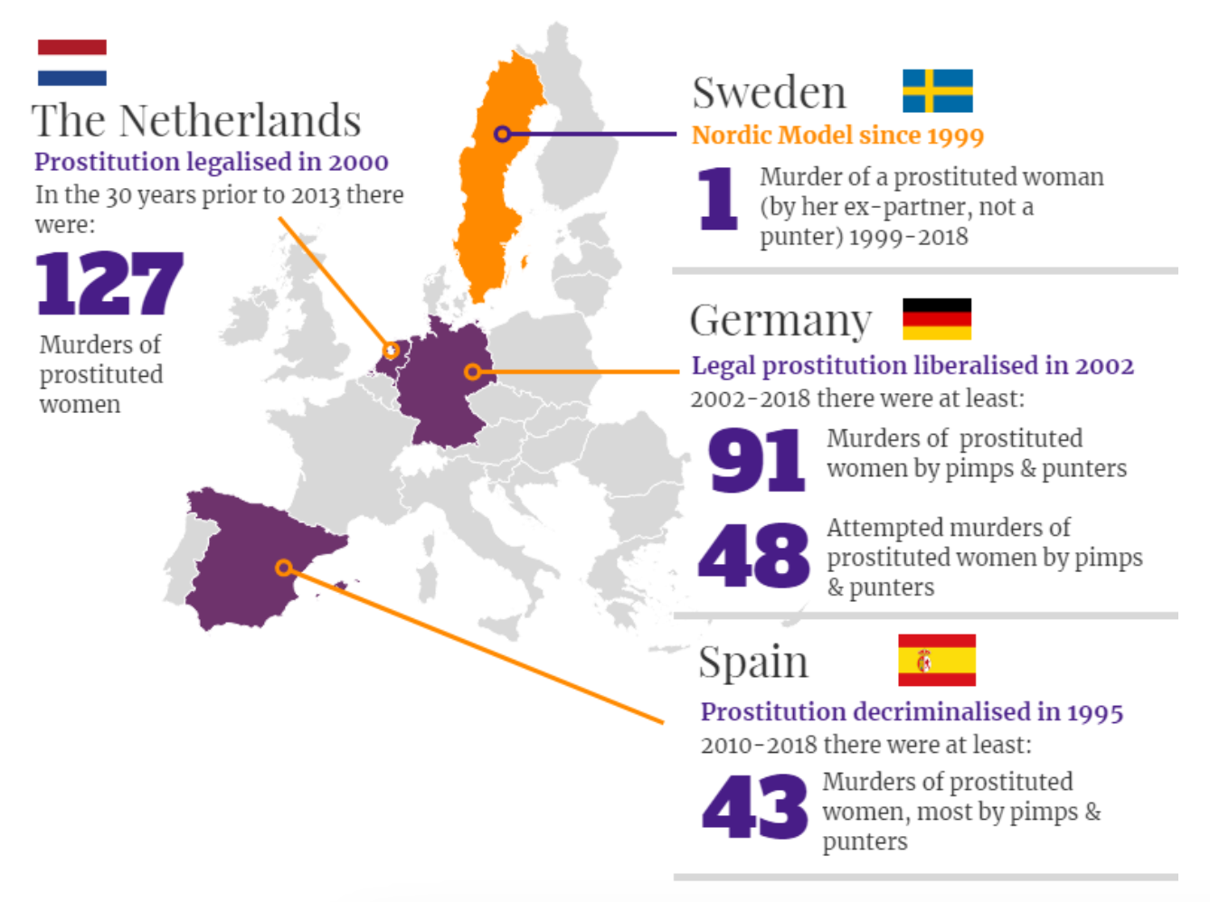
Murder
Rates
Compared
‘Law Hasn’t worked’
New Zealand PM
1
‘explosive increase in Trafficking’
German Police Chief
2
‘A failed
social experiment’
Mayor Amsterdam
3
Graphic: Nordic Model Now!
Notes:
Perhaps the ultimate test of what model works is by comparing murder rates.
It must be recognised that this is likely to be (massively) under represented, particularly where prostitution is legitimised
This also does not take into account the high level of other causes of prostitution-related death
(eg suicide, OD, or early death due to the
See:
'Legitimising Pimps' at
https://notbuyingit.org.uk/sex-trade-publications/
1) https://www.odt.co.nz/news/politics/prostitution-law-reform-hasn't-worked-pm
2)https://www.spiegel.de/international/germany/human-trafficking-persists-despite-legality-of-prostitution-in-germany-a-902533.html
3)https://www.spectator.co.uk/article/why-even-amsterdam-doesn-t-want-legal-brothels

Slide 12

Why ‘Sex Work’ doesn’t work - Market Forces *
  There is potentially huge profit to be made by exploiters
  So the industry everywhere is dominated by exploiters
  There is an unlimited global supply of potential ‘product’
Vulnerable/impoverished/socially groomed people who can easily be exploited -
probably the majority of the 7 billion inhabitants of the world
  So anywhere that makes it easier for exploiters, maximises profit, minimises risk/
penalties gives the ‘green light’ and will always be a hub of exploitation
If not enough ‘local product’, vulnerable people are readily imported
  Legitimising/enabling the industry in any shape or form gives that ‘green light’
  Criminalising all profiteering, all enabling and all buying can clearly ‘stop the industry in its tracks’
Notes:
Summary of just some of the wealth of evidence at:
'How to Deal with Prostitution' https://notbuyingit.org.uk/sex-trade-publications/
'Legitimising Pimps'
https://notbuyingit.org.uk/sex-trade-publications/

Slide 13
Why VAWG/Nordic Model Works*
Prostitution is an entirely unnecessary industry
Tackling Demand shrinks/end prostitution
Ending Demand Readily Achievable
Criminalise + small fines/exposure = 90% Reduction in Sex Buying
90% in Industry want to exit
None would ‘chose’ industry if fully informed/genuine choice
  VAWG – Violence Against Women and Girls
Notes:
*Multiple global reports available showing this.
See:
'Inevitable' at https://notbuyingit.org.uk/sex-trade-publications/
See recent APPG CSE report: https://www.appg-cse.uk/wp-content/uploads/2024/02/Men-Who-Buy-Sex-APPG-report.pdf

